Slide 1

Automating Attendance Using RFID
Smart IoT-Based Attendance Monitoring

Slide 2
CONTENTS
01
02
03
Abstract
Introduction
Objectives
04
05
06
Hardware & Software
System Architecture
Advantages & Disadvantages
07
Implementation & Results

Slide 3

Abstract: RFID Attendance
Project Purpose
Real-time Data
Automating attendance using RFID technology.
Integration with Google Sheets for instant data access.
Cloud Connectivity
Benefits
ESP8266 connects the system to the cloud.
Reduces manual errors, saves time, provides transparency.

Slide 4

Introduction: The Need for Automation
Traditional attendance systems often suffer from inefficiencies and inaccuracies. The need for automation and precise data recording is paramount in modern institutions and workplaces.
RFID technology offers a robust solution for identification, while cloud-based storage ensures data accessibility and security. This system is ideal for schools, colleges, and offices.

Slide 5




Key Objectives
Automate Recording
Streamline the attendance process.
Instant Data
Provide real-time updates to Google Sheets.
Secure Storage
Ensure data integrity and reliability.
Increase Efficiency
Reduce manual effort and paperwork.

Slide 6
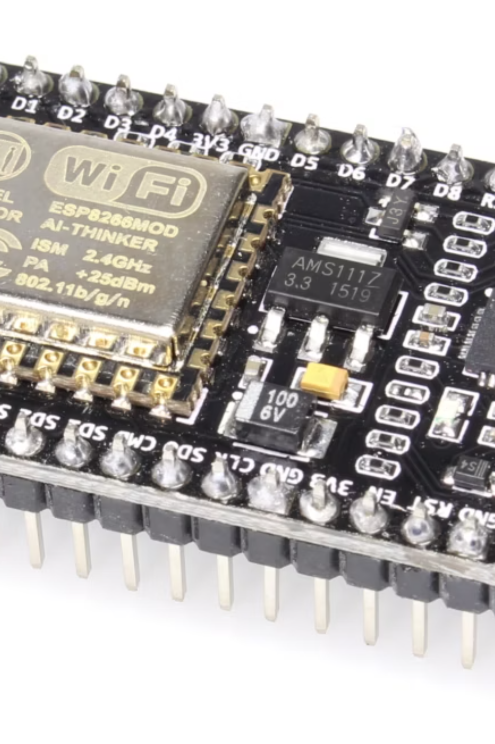
Hardware & Software Requirements
Hardware
Software
ESP8266 Microcontroller
Arduino IDE
RFID Reader RC522
ESP8266 Board Package
RFID Tags
Google Apps Script
Power Supply
Google Sheets API
Breadboard & Jumper Wires
Internet Connectivity

Slide 7





System Architecture
RFID Card
RFID Reader
Google Sheets
ESP8266
The system captures RFID card data, processes it via ESP8266, and uploads it to Google Sheets. User feedback is provided through an LCD and buzzer.

Slide 8
Advantages & Disadvantages
Advantages
Disadvantages
Real-time data
Internet dependency
Automated attendance
Hardware dependency
Easy monitoring
Complex setup
Cloud storage
Maintenance issues
Reduced errors
Security concerns

Slide 9
Implementation & Results
The system successfully records attendance data in Google Sheets, demonstrating real-time updates and efficient data management.
9/14/2025
11:11:10
2023PECEC391
SANJAY
ECE
CHENNAI
9/14/2025
11:12:50
2023PECEC395
RAM
ECE
PORUR
9/14/2025
11:15:10
2023PECEC392
SANDY
ECE
REDHILLS

Slide 10
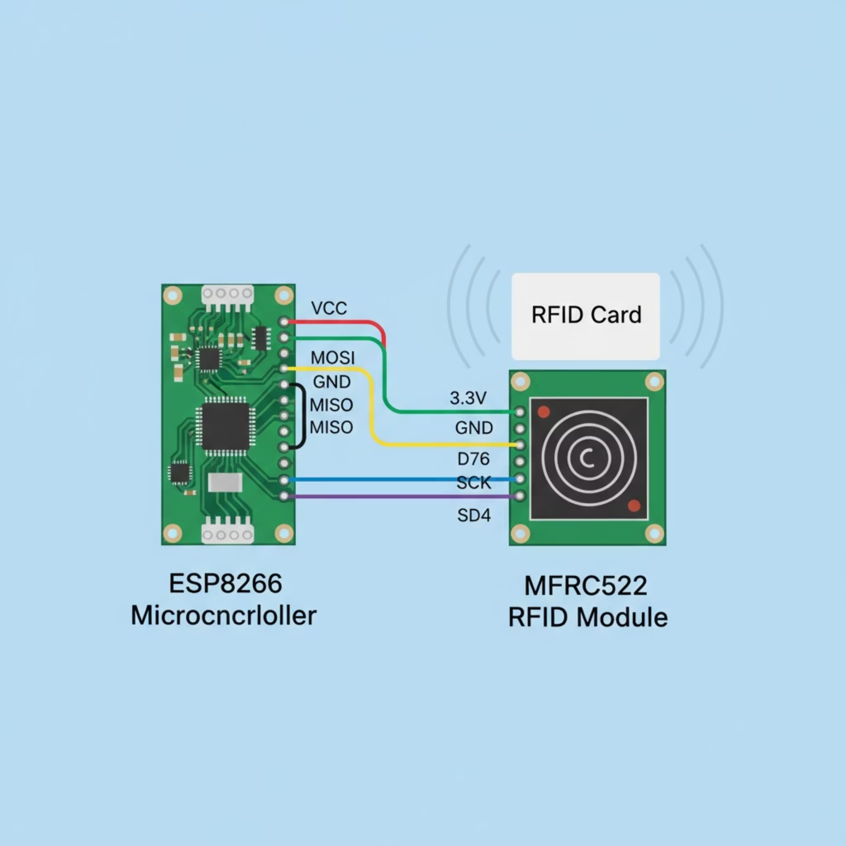
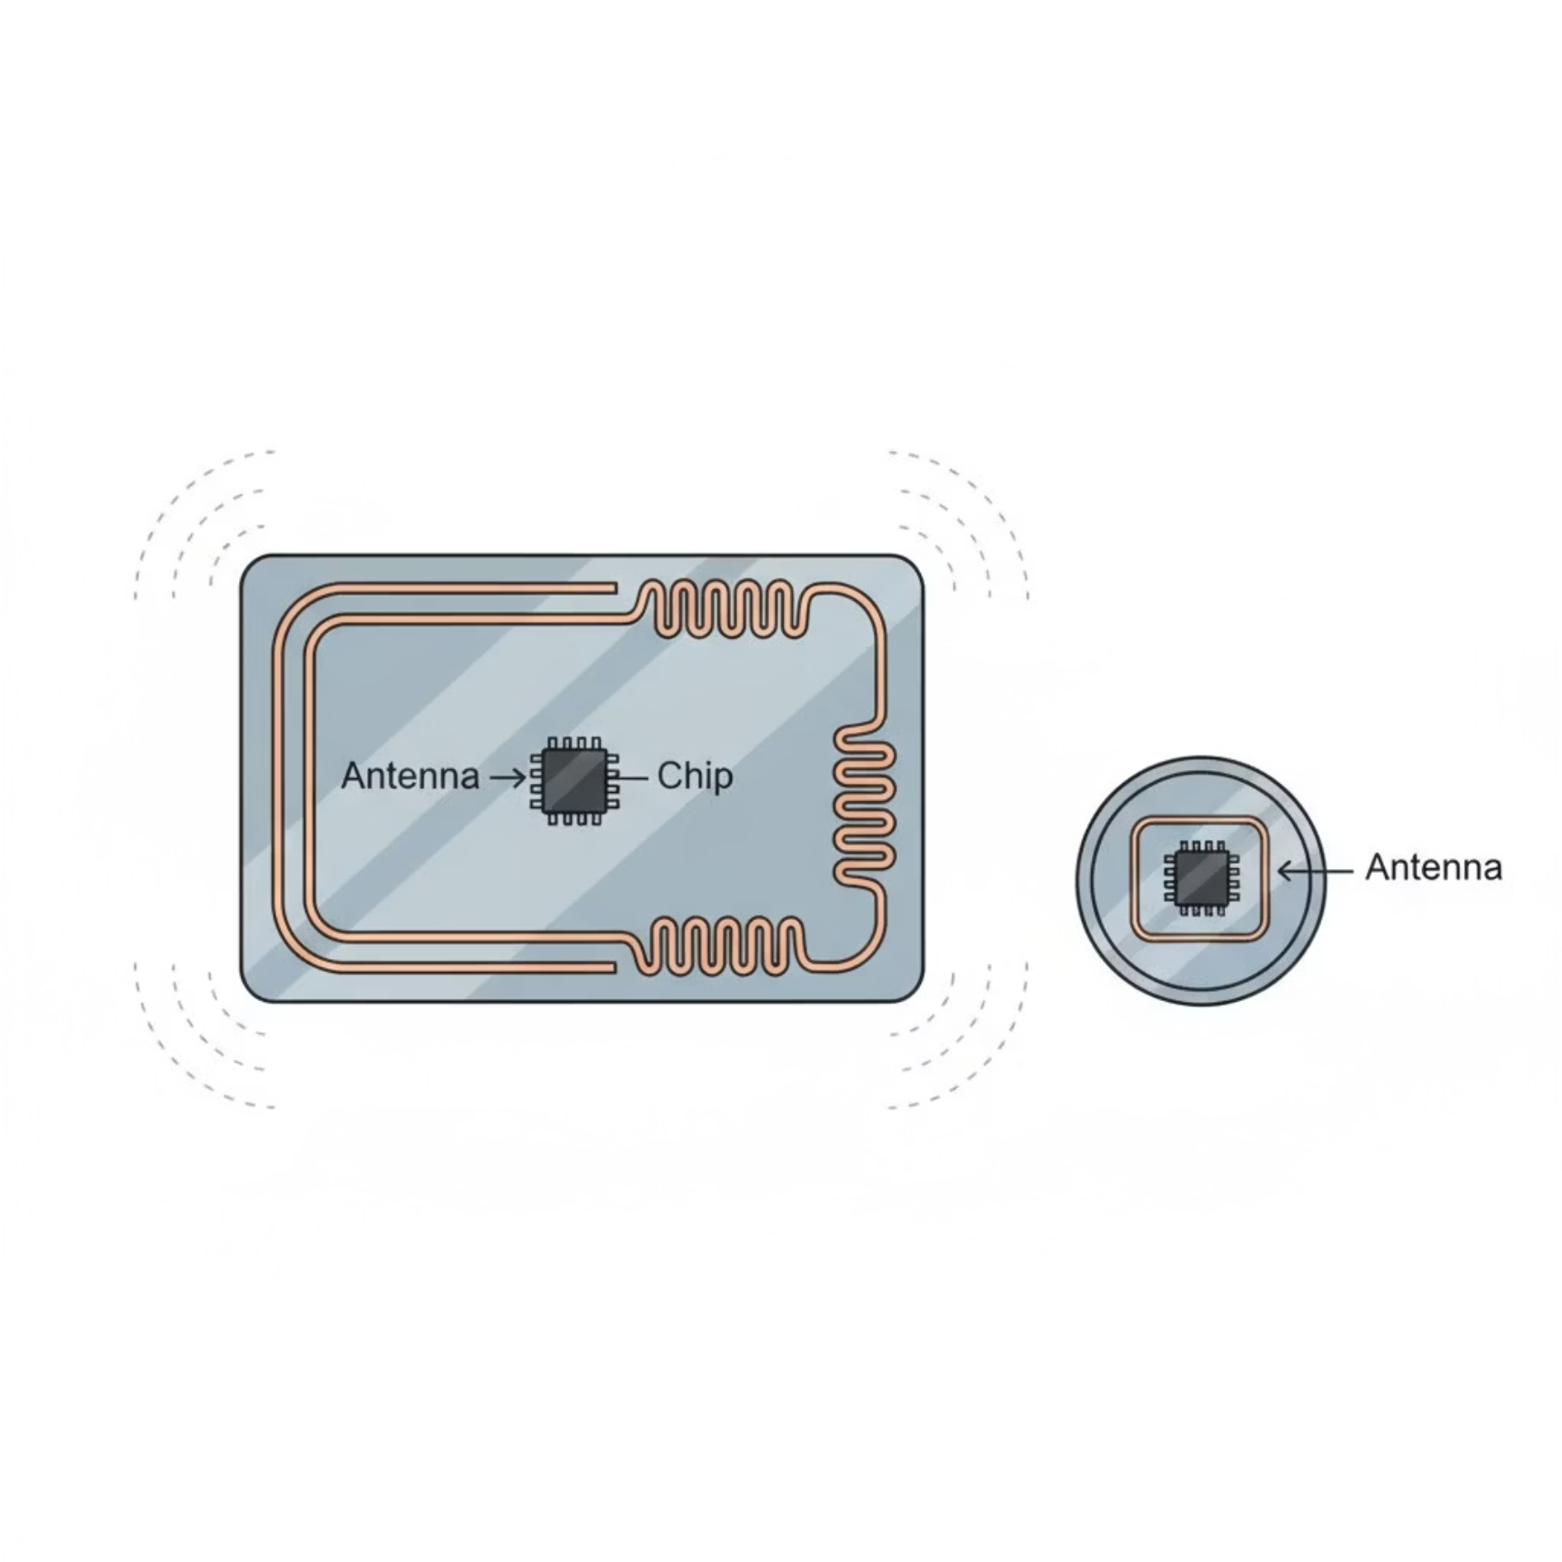

Slide 11
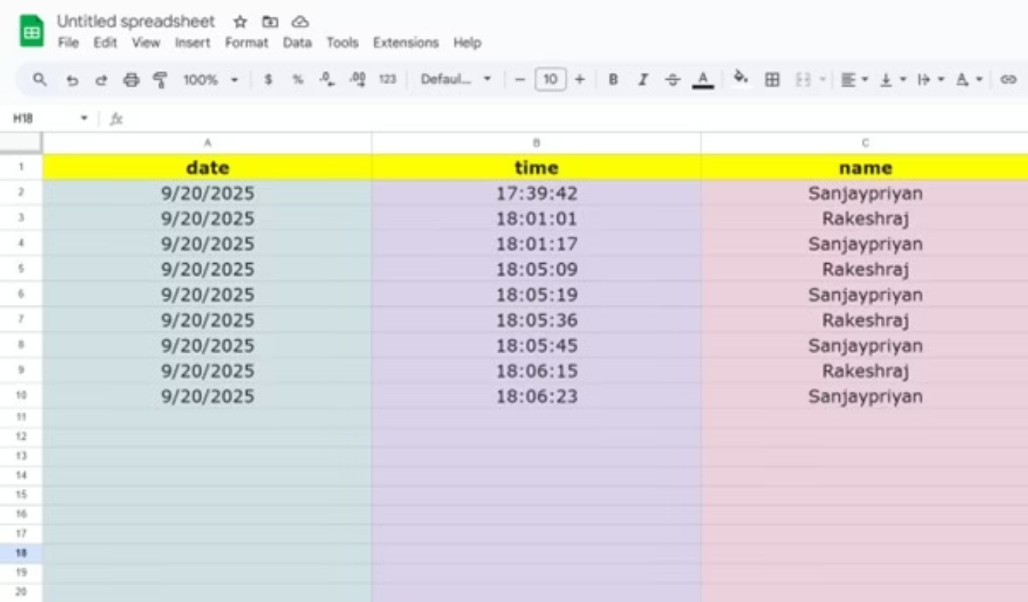

Slide 12
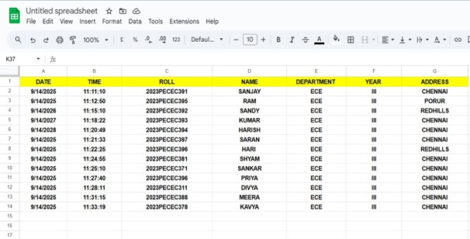

Slide 13
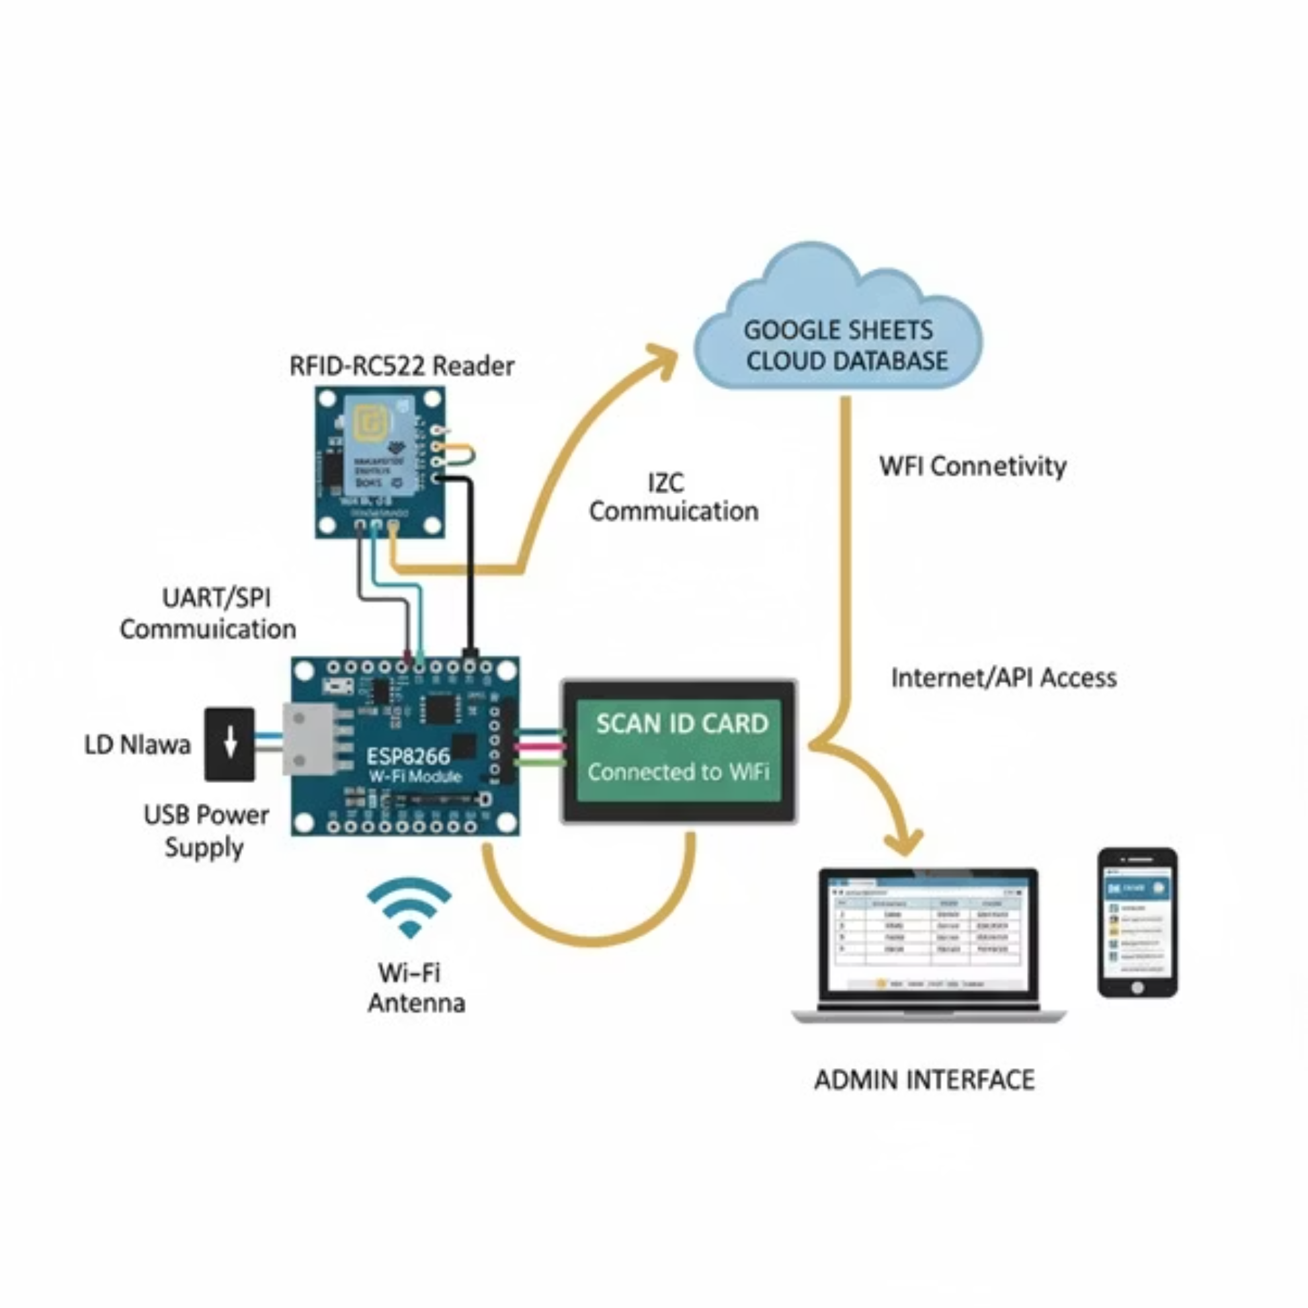

Slide 14
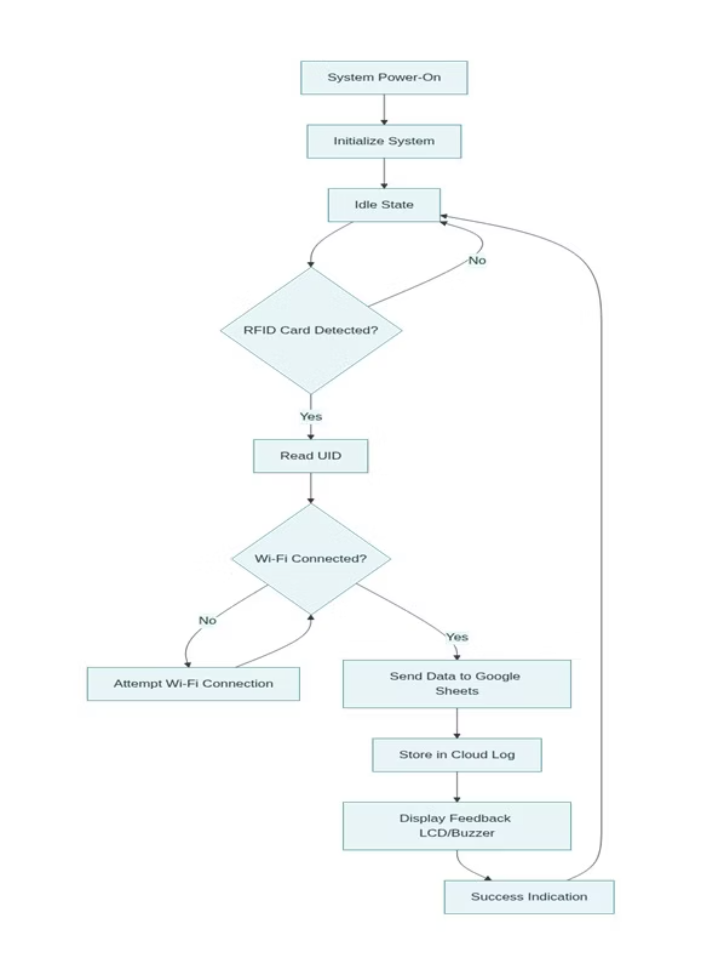
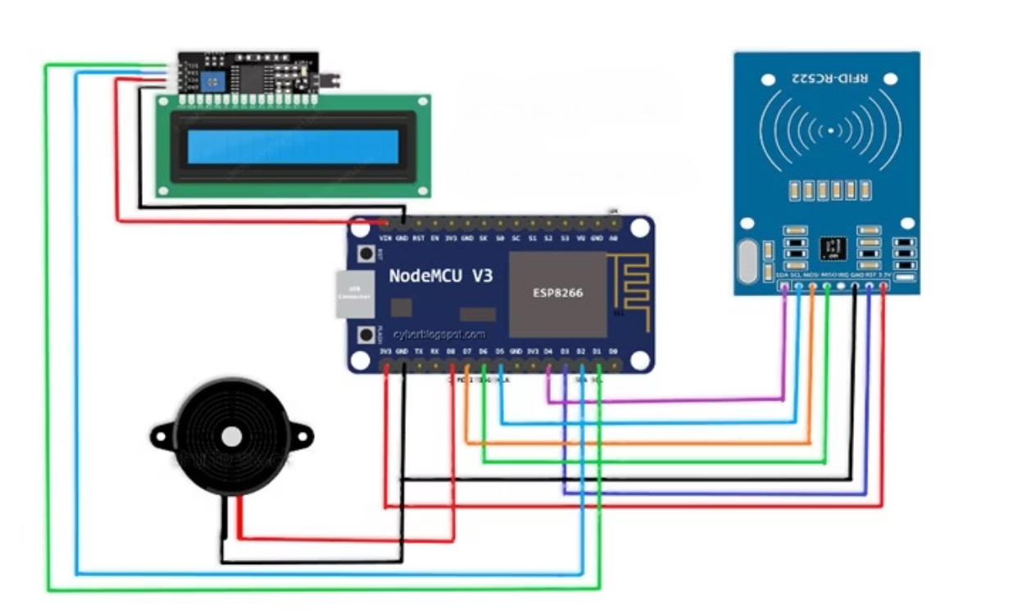

Slide 15

Presented by:
Thank You
SANJAY PRIYAN M
SHANMUGA SUNDARAM S
SANJAY M
RAKESH RAJ G

